Slide 1
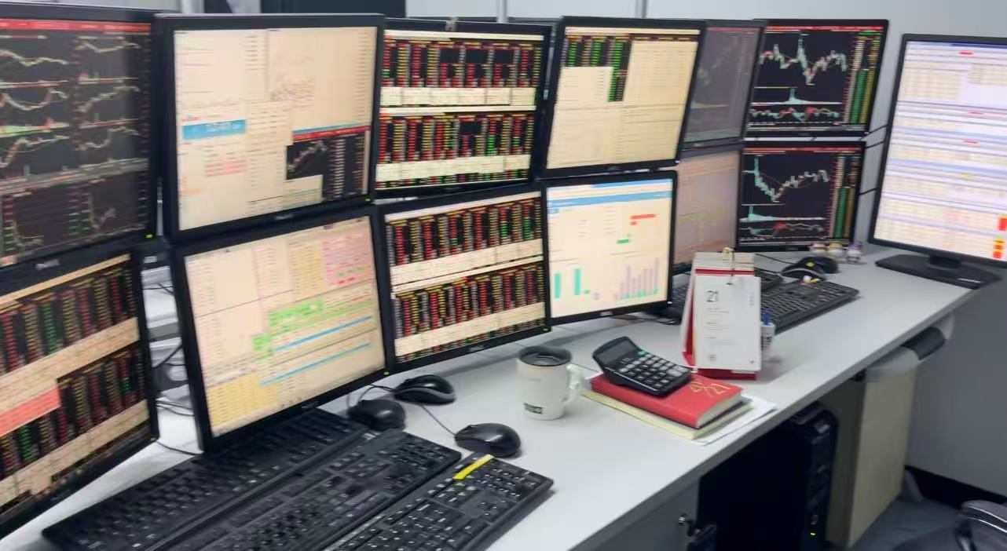
OIM7510 · LIGHTNING TALK
Would AI Have Made My Trade?
From a class mini-project, to a trading room, and back
Yashu · Oct 20, 2026
Notes:
[~5s] Hi everyone. My question today is: would AI have made my trade?

Slide 2
I wrote the rule. The code followed it.
Mini-project 1: a simple portfolio tool
Rebalancing threshold
Rebalancing threshold
5 pts
7 pts
More trades
Higher fees
Fewer trades, lower fees
But more idle cash
The code follows the rule. Choosing the rule is the real decision.
Notes:
[~30s] For our first mini-project, I built a simple portfolio tool. It rebalances when a position drifts past a threshold. I tried 5 points, then 7. At 7, it traded less and paid fewer fees, but more cash sat idle. The code did exactly what I told it. But choosing the rule was the real decision.

Slide 3
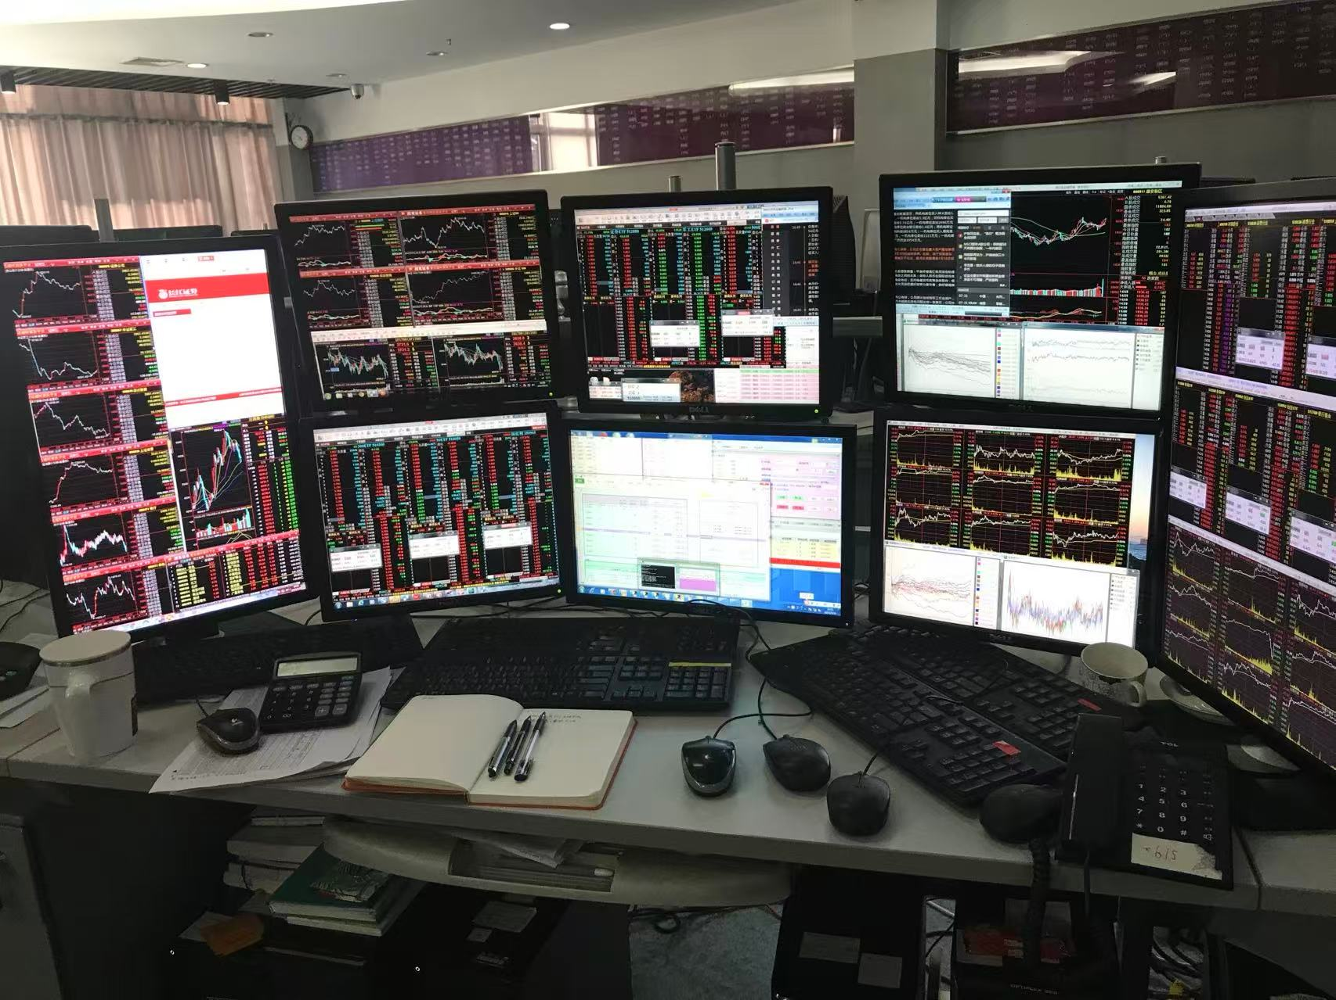
A few years ago, this took a team
THEN
Trader
→
PM
→
IT developers
Weeks to months
NOW
One person + AI coding tools
Days
And Jane Street now runs AI on custom Etched chips.
Our trading room
Notes:
[~30s] Before my MBA, I spent over ten years in trading and portfolio management in China. This was our trading room. Back then, when I had a strategy idea, I explained it to the PM, the PM explained it to IT, and the developers built it. That took weeks, sometimes months. Today I can build something like my mini-project myself, in days, with AI. And firms like Jane Street now run AI on custom chips. In just a few years, the whole way of working changed.

Slide 4
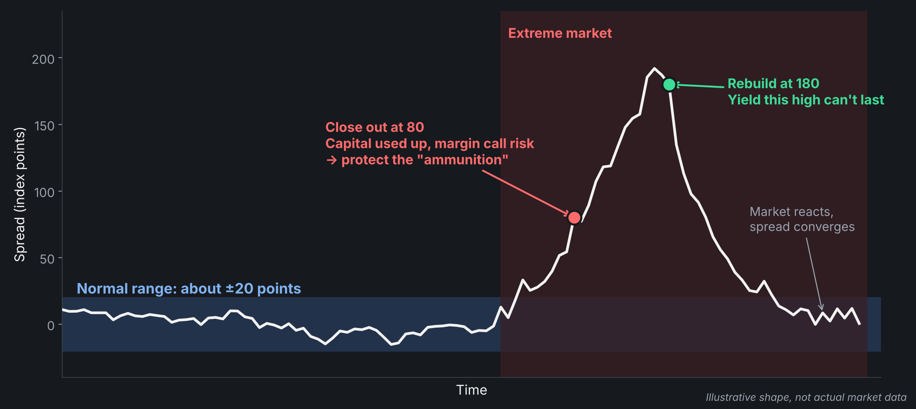
When the rule breaks
IF300 futures and the ETF track the same 300 stocks. Normally, the gap stays within about ±20 points.
Notes:
[~60s] But a rule only works until the market breaks it. One of our strategies traded the gap, the basis, between IF300 index futures and the ETF. They track the same 300 stocks, so normally the gap stays within about plus or minus 20 points. Then came an extreme market. The gap went far beyond anything our historical data said was possible. We had used up our available capital, and the gap kept getting worse. Futures are leveraged, so if we couldn't meet a margin call, we could be forced out at any time. As team lead, risk came first. At 80, I ordered a close-out. Not because I thought the trade was wrong, but to keep our ammunition. Then the gap hit 180. That yield was extremely high, and I knew it couldn't last. Once the market reacted, it would shrink fast. So we rebuilt the position. And it did shrink.
[IF 5 MIN] Add: how fast we had to decide, what the room felt like at 180, who I had to convince to rebuild.

Slide 5
Sometimes there is no second chance
−50M
−200M
150M saved
RMB loss we took by cutting the position
RMB loss if we had held (the stock was later liquidated)
We know the 200M now. I had to decide before anyone knew, with no prior data like it.
Notes:
[~40s] That time, we got a second chance. Not every decision gives you one. In another case, I cut a stock position and took a real loss: 50 million RMB. Later, that stock was liquidated, so we know exactly what holding would have cost: 200 million. But that number only exists afterward. When I made the call, no data looked like that situation. And on paper, my decision just says minus 50 million.
[IF 5 MIN] Add: what signal made me act, and how it felt to report a 50M loss without being able to prove the 200M yet.

Slide 6
Would you authorize the exit?
An AI recommends closing a position and realizing a large loss. You cannot yet know whether it is right.
A
Let the AI execute
B
Require human approval
What would change your answer?
Notes:
[~15s, then discussion] So here is my question. An AI recommends closing a position and taking a big loss. You can't know yet if it's right. Would you? A: let the AI execute. Or B: require human approval. Hands up for A... and for B. [Call on one person from each side.] What would change your answer?
FOLLOW-UPS: If someone says the outcome proves it was right: Was it judgment or luck? What evidence, available BEFORE the outcome, would tell the difference? / Would your answer change with the size of the loss? The AI's track record? If it could explain its reasoning?
CLOSE: Thank you. Back to you, Professor.

